Slide 1
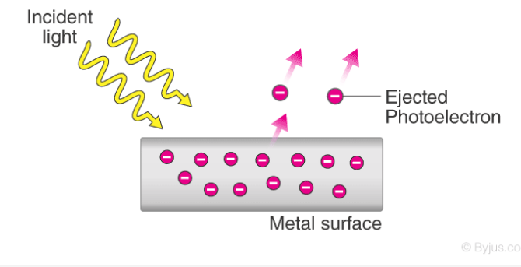
What is the Photoelectric Effect
The photoelectric effect is a phenomenon in which electrons are ejected from the surface of a metal when light is incident on it.

Slide 2
These ejected electrons are called photoelectrons. The process through which photoelectrons are ejected from the surface of the metal due to the action of light is commonly referred to as photoemission.

Slide 3
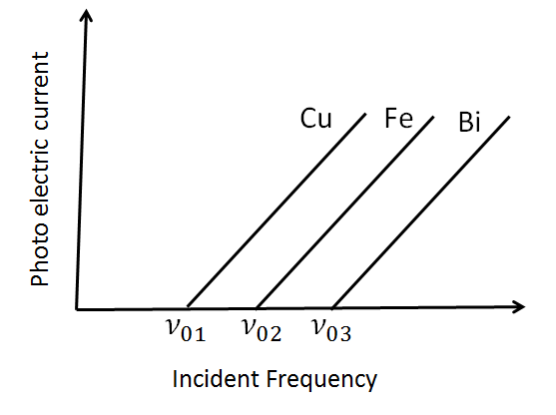
It is important to note that the emission of photoelectrons and the kinetic energy of the ejected photoelectrons is dependent on the frequency of the light that is incident on the metal’s surface.

Slide 4
Why does it Occur?
The photoelectric effect occurs because the electrons at the surface of the metal tend to absorb energy from the incident light and use it to overcome the attractive forces that bind them to the metallic nuclei. An illustration detailing the emission of photoelectrons as a result of the photoelectric effect is provided below.

Slide 5
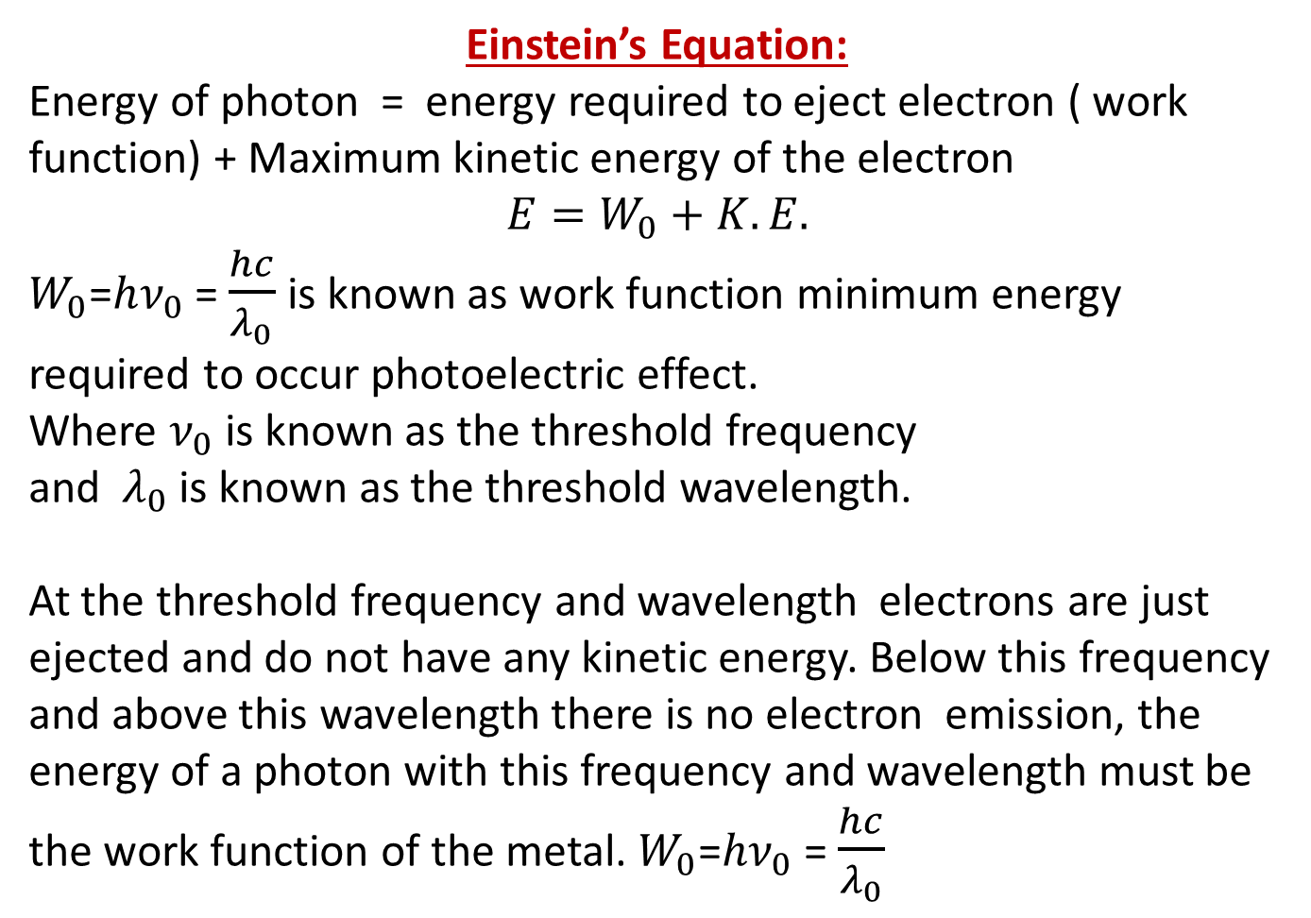
Einstein’s Equation:
Energy of photon = energy required to eject electron ( work function) + Maximum kinetic energy of the electron
$$E=W_{0}+K.E.$$
$W_{0}$=$hν_{0}$ = $\frac{hc}{λ_{0}}$ is known as work function minimum energy required to occur photoelectric effect.
Where $ν_{0}$ is known as the threshold frequency
and $λ_{0}$ is known as the threshold wavelength.
At the threshold frequency and wavelength electrons are just ejected and do not have any kinetic energy. Below this frequency and above this wavelength there is no electron emission, the energy of a photon with this frequency and wavelength must be the work function of the metal. $W_{0}$=$hν_{0}$ = $\frac{hc}{λ_{0}}$

Slide 6
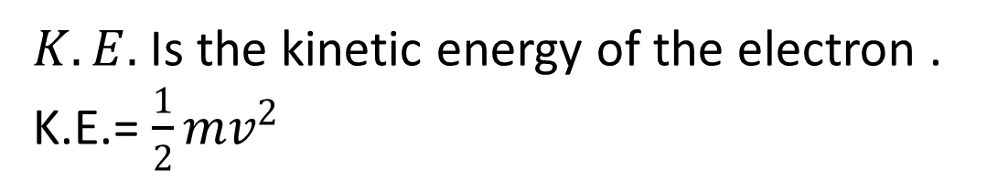
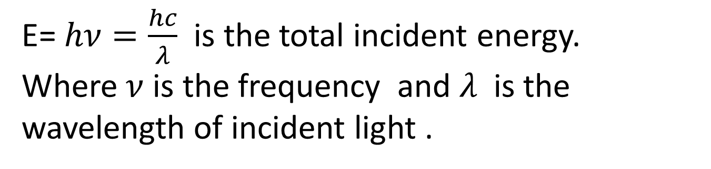
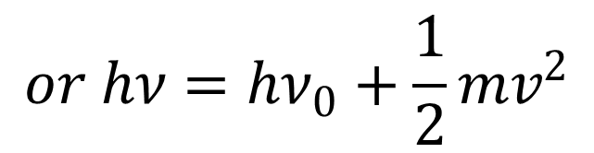
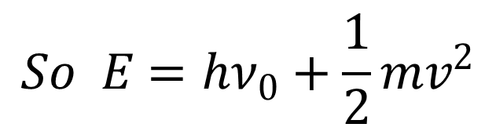
E= $hν=\frac{hc}{λ}$ is the total incident energy.
Where $ν$ is the frequency and $λ$ is the
wavelength of incident light .
$K.E.$Is the kinetic energy of the electron .
K.E.= $\frac{1}{2}mv^{2}$
$$So E=hν_{0}+\frac{1}{2}mv^{2}$$
$$or hν=hν_{0}+\frac{1}{2}mv^{2}$$

Slide 7
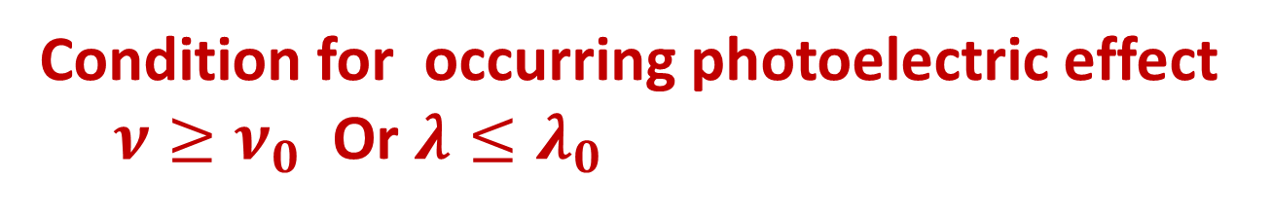
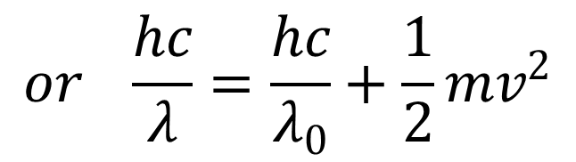
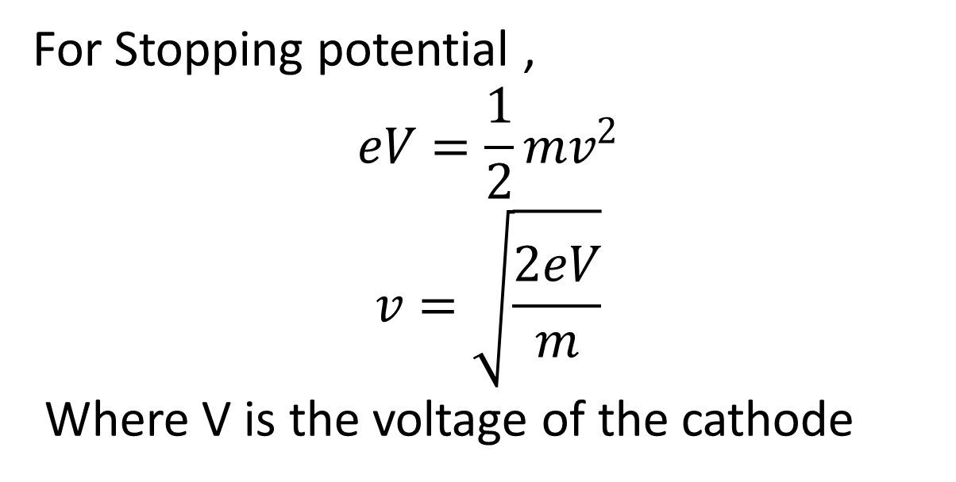
$$or \frac{hc}{λ}=\frac{hc}{λ_{0}}+\frac{1}{2}mv^{2}$$
Condition for occurring photoelectric effect
$ν≥ν_{0}$ Or $λ≤λ_{0}$
For Stopping potential ,
$$eV=\frac{1}{2}mv^{2}$$
$$v=\sqrt{\frac{2eV}{m}}$$
Where V is the voltage of the cathode

Slide 8
The photoelectric effect has three important characteristics that cannot be explained by classical physics:
The absence of a lag time.
The independence of the kinetic energy of photoelectrons on the intensity of incident radiation.
The presence of a cut-off frequency.

Slide 9
-:Properties of Photoelectric Effect:-
It’s an instantaneous process. There is no time lag between incident photon and ejected electron.
Kinetic energy of the photoelectrons depends on the incident frequency of light but not on intensity of incident light.
Number of photoelectrons i.e. photo electricity depends on the intensity of incident light but not on the frequency.

Slide 10
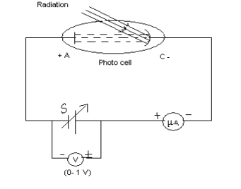

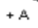

Slide 11
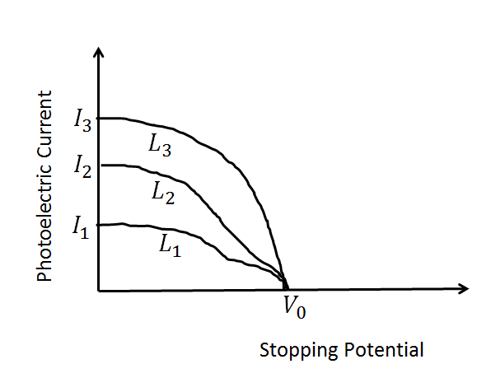

Slide 12
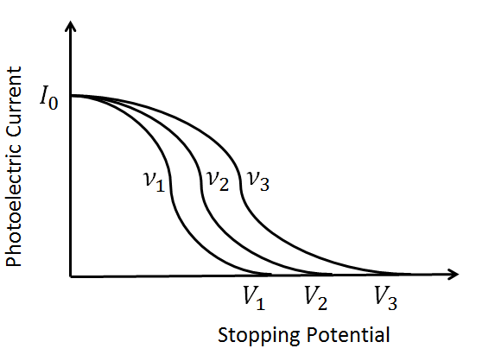

Slide 13
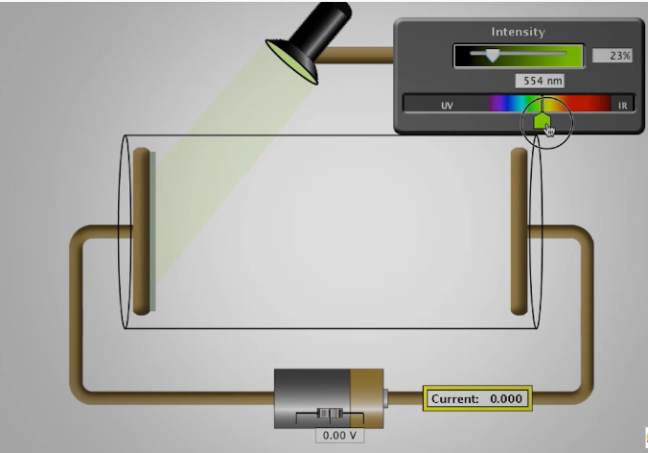

Slide 14
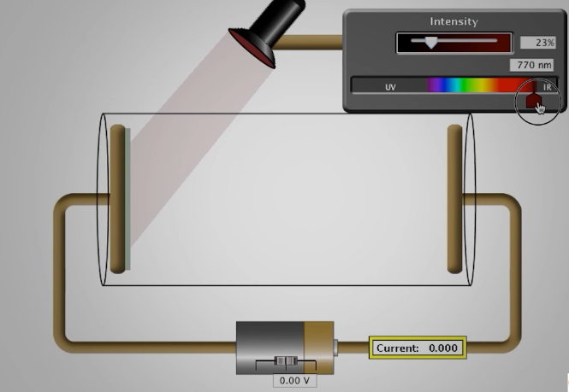

Slide 15
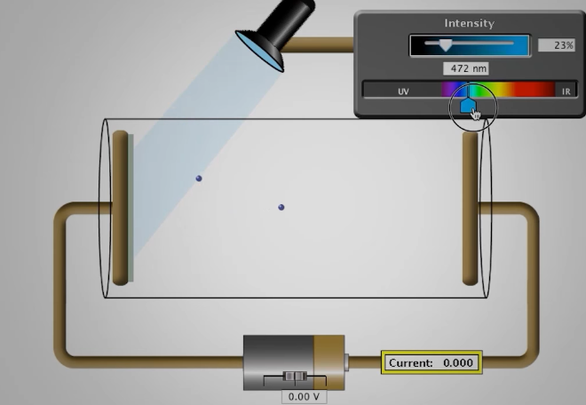

Slide 16
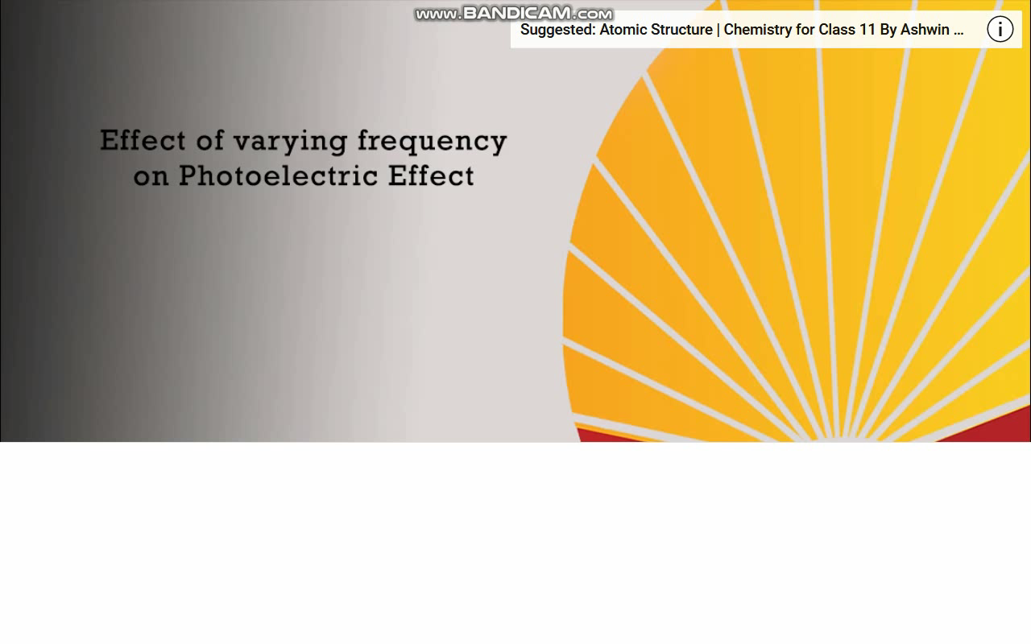

Slide 17
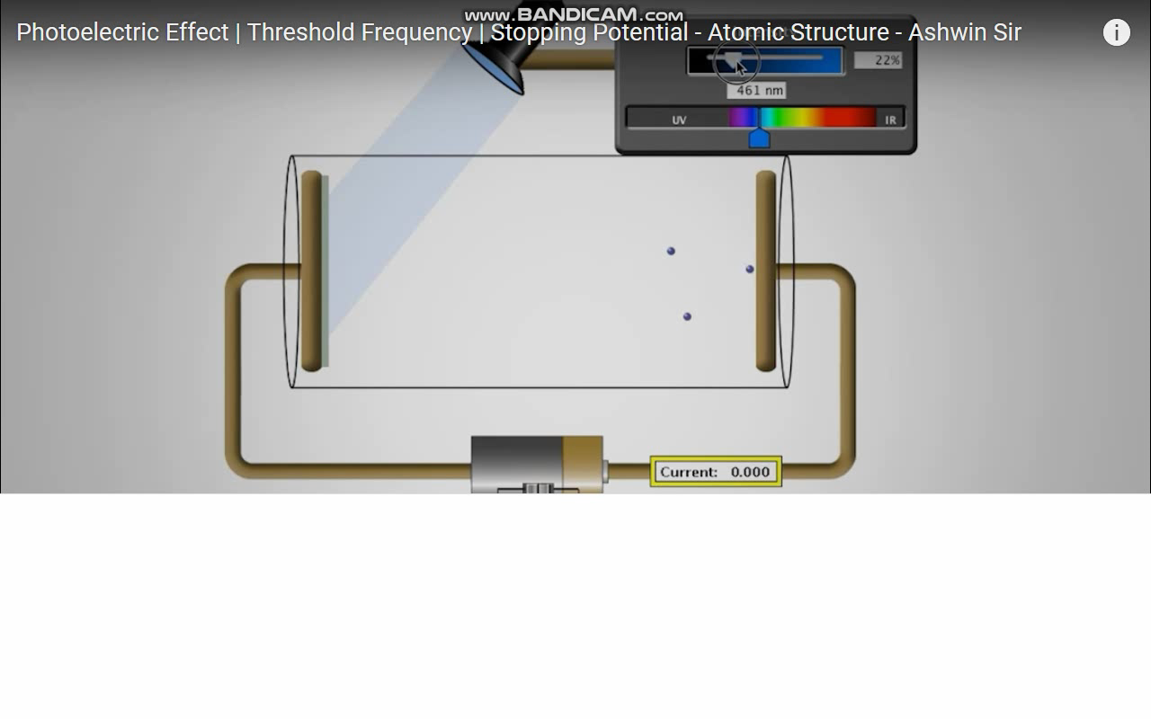

Slide 18
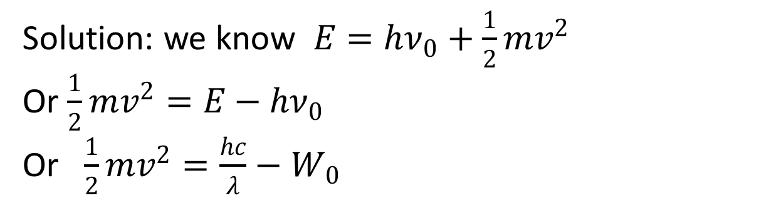
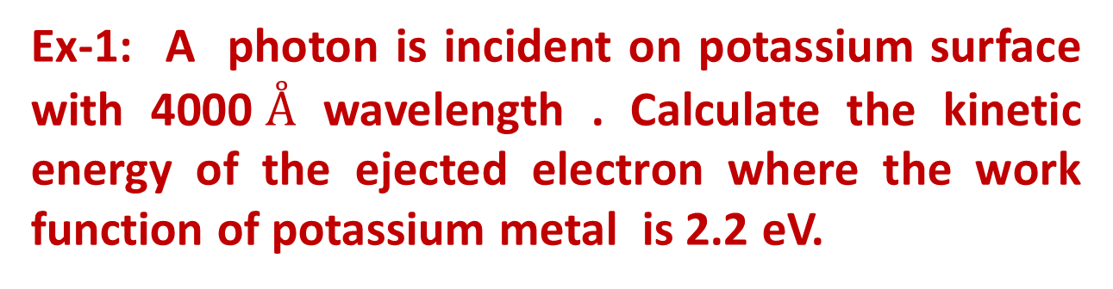
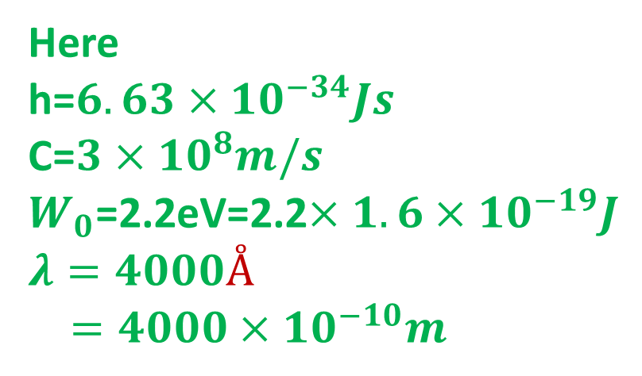
Ex-1: A photon is incident on potassium surface with 4000$Å$ wavelength . Calculate the kinetic energy of the ejected electron where the work function of potassium metal is 2.2 eV.
Solution: we know $E=hν_{0}+\frac{1}{2}mv^{2}$
Or $\frac{1}{2}mv^{2}=E−hν_{0}$
Or $\frac{1}{2}mv^{2}=\frac{hc}{λ}−W_{0}$
Here
h=$6.63×{10}^{−34}Js$
C=$3×{10}^{8}m/s$
$W_{0}$=2.2eV=2.2$×1.6×{10}^{−19}J$
$$λ=4000Å$$
$=4000×{10}^{−10}m$

Slide 19
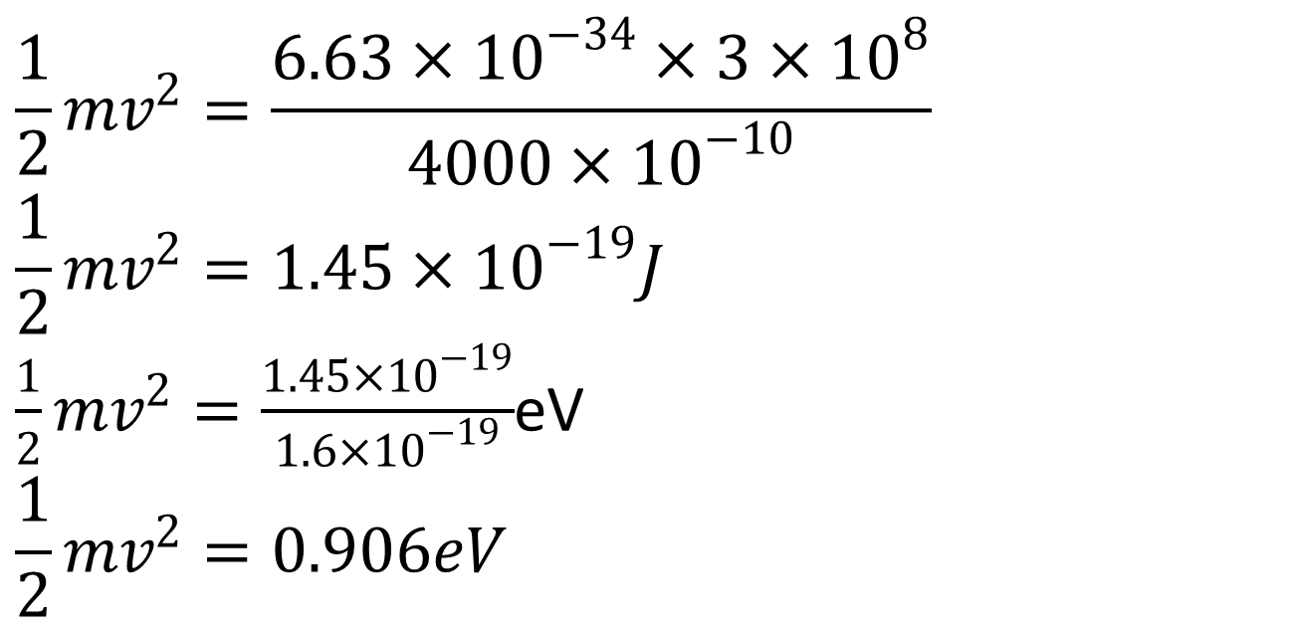
$$\frac{1}{2}mv^{2}=\frac{6.63×{10}^{−34}×3×{10}^{8}}{4000×{10}^{−10}}$$
$$\frac{1}{2}mv^{2}=1.45×{10}^{−19}J$$
$\frac{1}{2}mv^{2}=\frac{1.45×{10}^{−19}}{1.6×{10}^{−19}}$eV
$$\frac{1}{2}mv^{2}=0.906eV$$

Slide 20
Ex-2: If a metal with a threshold frequency of 1.1×10¹⁵ Hz is illuminated by light with a wavelength of 170 nm, then what will the maximum kinetic energy of the emitted photoelectron be?

Slide 21
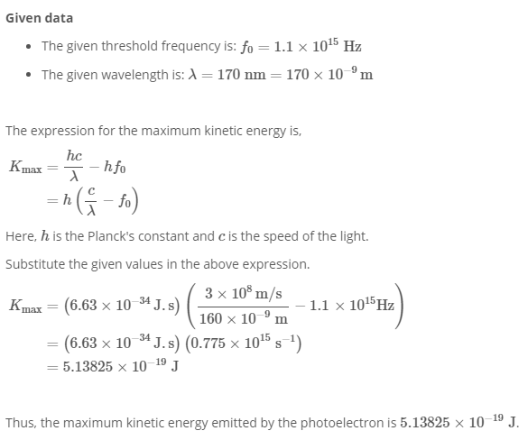

Slide 22
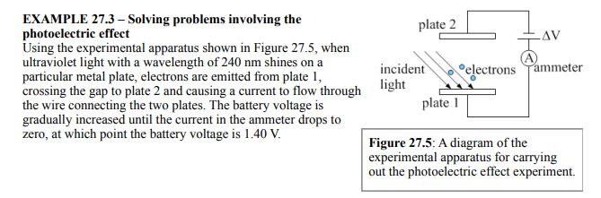

Slide 23
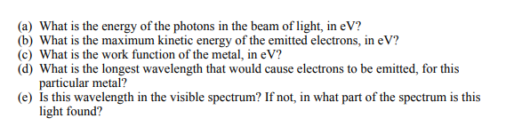

Slide 24
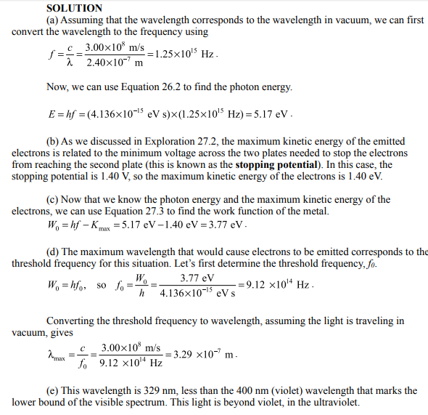

Slide 25
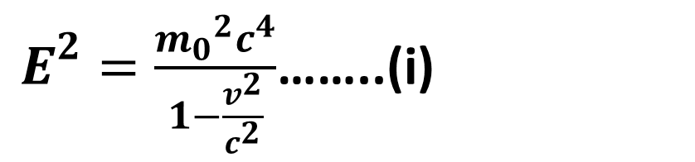
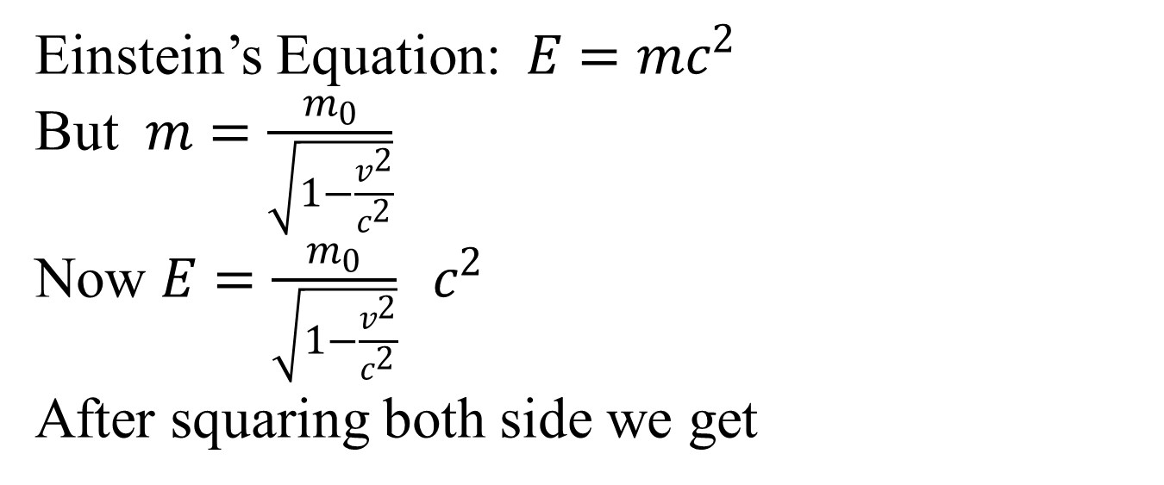
Relativistic Energy and Momentum
Einstein’s Equation: $E=mc^{2}$
But $m=\frac{m_{0}}{\sqrt{1−\frac{v^{2}}{c^{2}}}}$
Now $E=\frac{m_{0}}{\sqrt{1−\frac{v^{2}}{c^{2}}}} c^{2}$
After squaring both side we get
$E^{2}=\frac{{m_{0}}^{2}c^{4}}{1−\frac{v^{2}}{c^{2}}}$……..(i)

Slide 26
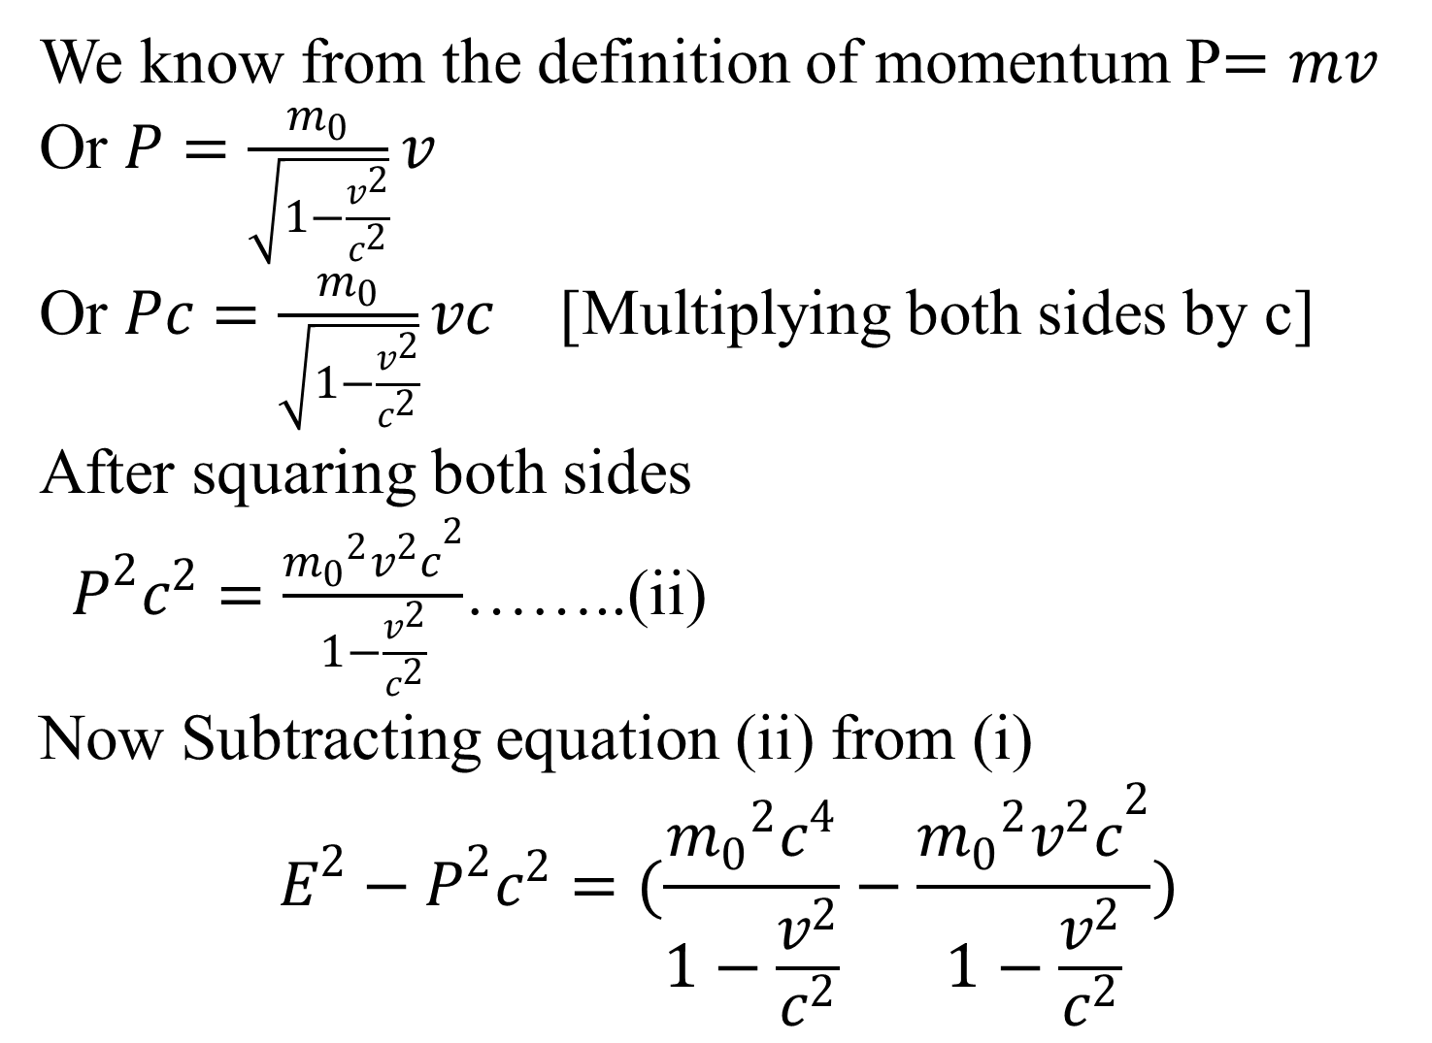
We know from the definition of momentum P$=mv$
Or $P=\frac{m_{0}}{\sqrt{1−\frac{v^{2}}{c^{2}}}}v$
Or $Pc=\frac{m_{0}}{\sqrt{1−\frac{v^{2}}{c^{2}}}}vc$ [Multiplying both sides by c]
After squaring both sides
$P^{2}c^{2}=\frac{{m_{0}}^{2}{v^{2}c}^{2}}{1−\frac{v^{2}}{c^{2}}}$……..(ii)
Now Subtracting equation (ii) from (i)
$$E^{2}−P^{2}c^{2}=(\frac{{m_{0}}^{2}c^{4}}{1−\frac{v^{2}}{c^{2}}}−\frac{{m_{0}}^{2}{v^{2}c}^{2}}{1−\frac{v^{2}}{c^{2}}})$$

Slide 27
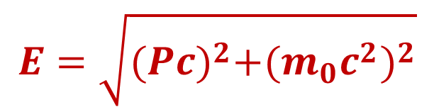
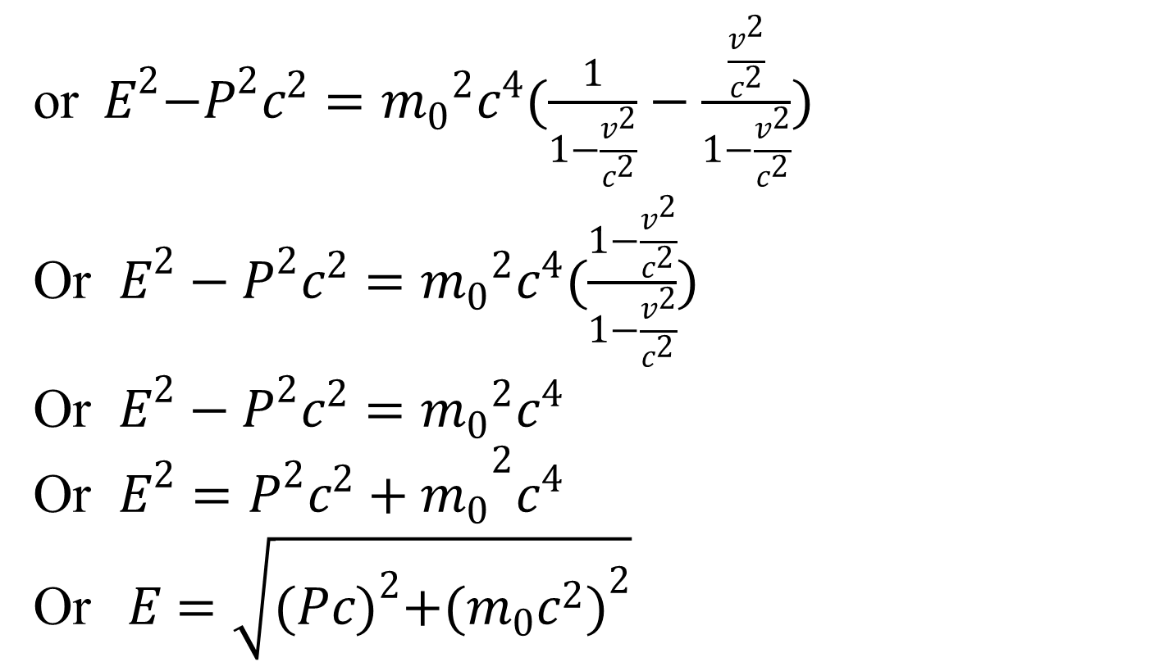
or${ E}^{2}−P^{2}c^{2}={m_{0}}^{2}c^{4}(\frac{1}{1−\frac{v^{2}}{c^{2}}}−\frac{\frac{v^{2}}{c^{2}}}{1−\frac{v^{2}}{c^{2}}})$
Or $E^{2}−P^{2}c^{2}={m_{0}}^{2}c^{4}(\frac{1−\frac{v^{2}}{c^{2}}}{1−\frac{v^{2}}{c^{2}}})$
Or $E^{2}−P^{2}c^{2}={m_{0}}^{2}c^{4}$
Or $E^{2}={P^{2}c^{2}+m_{0}}^{2}c^{4}$
Or$E=\sqrt{{(Pc)}^{2}+{(m_{0}c^{2})}^{2}}$
$$E=\sqrt{{(Pc)}^{2}+{(m_{0}c^{2})}^{2}}$$
This equation is known as the relation between relativistic energy and momentum

Slide 28
Heisenberg's Uncertainty Principle
Heisenberg's Uncertainty Principle states that there is inherent uncertainty in the act of measuring a variable of a particle. Commonly applied to the position and momentum of a particle, the principle states that the more precisely the position is known the more uncertain the momentum is and vice versa.

Slide 29
if one knows the precise momentum of the particle, it is impossible to know the precise position, and vice versa. This relationship also applies to energy and time, in that one cannot measure the precise energy of a system in a finite amount of time.
Uncertainties in the products of “conjugate pairs” (momentum/position) and (energy/time) were defined by Heisenberg as having a minimum value corresponding to Planck’s constant divided by 4π.

Slide 30
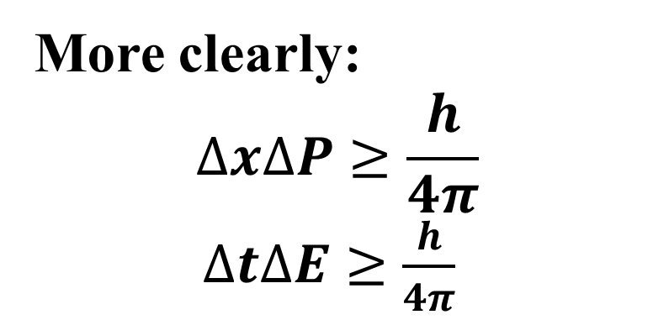
More clearly:
$$∆x∆P≥\frac{h}{4π}$$
$∆t∆E≥\frac{h}{4π}$
Ex-1: The uncertainty in the momentum Δp of a football thrown by Tom Brady during the super bowl traveling at 40m/s is 1×10⁻⁶ times of its momentum. What is its uncertainty in position Δx? Mass=0.40kg

Slide 31
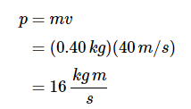
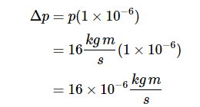
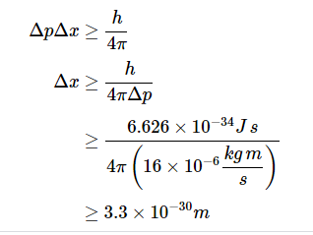

Slide 32
Electron can not exist in the nucleus . We can assume it by uncertainty principle.
Usually we can measure the energy of orbital electron in atom in eV range . Till now energy in MeV or GeV range has not been found. So electron having MeV or GeV can not be existed in nucleus.

Slide 33
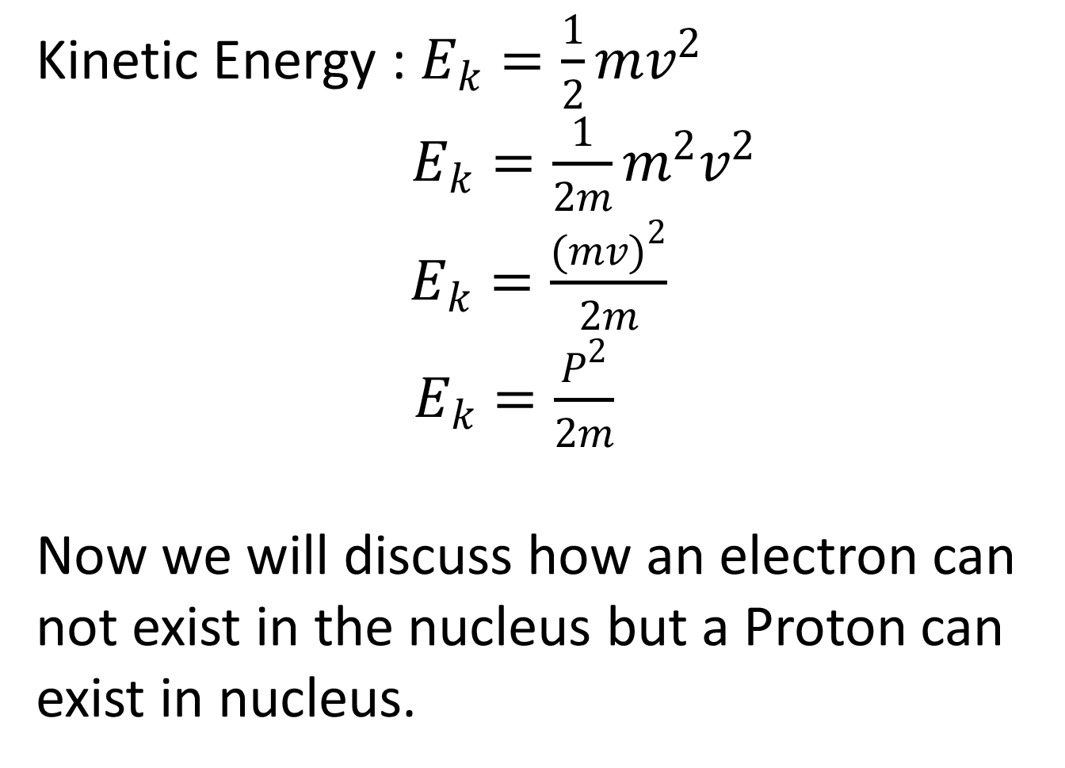
Kinetic Energy : $E_{k}=\frac{1}{2}mv^{2}$
$E_{k}=\frac{1}{2m}m^{2}v^{2}$
$E_{k}=\frac{{(mv)}^{2}}{2m}$
$E_{k}=\frac{P^{2}}{2m}$
Now we will discuss how an electron can not exist in the nucleus but a Proton can exist in nucleus.

Slide 34
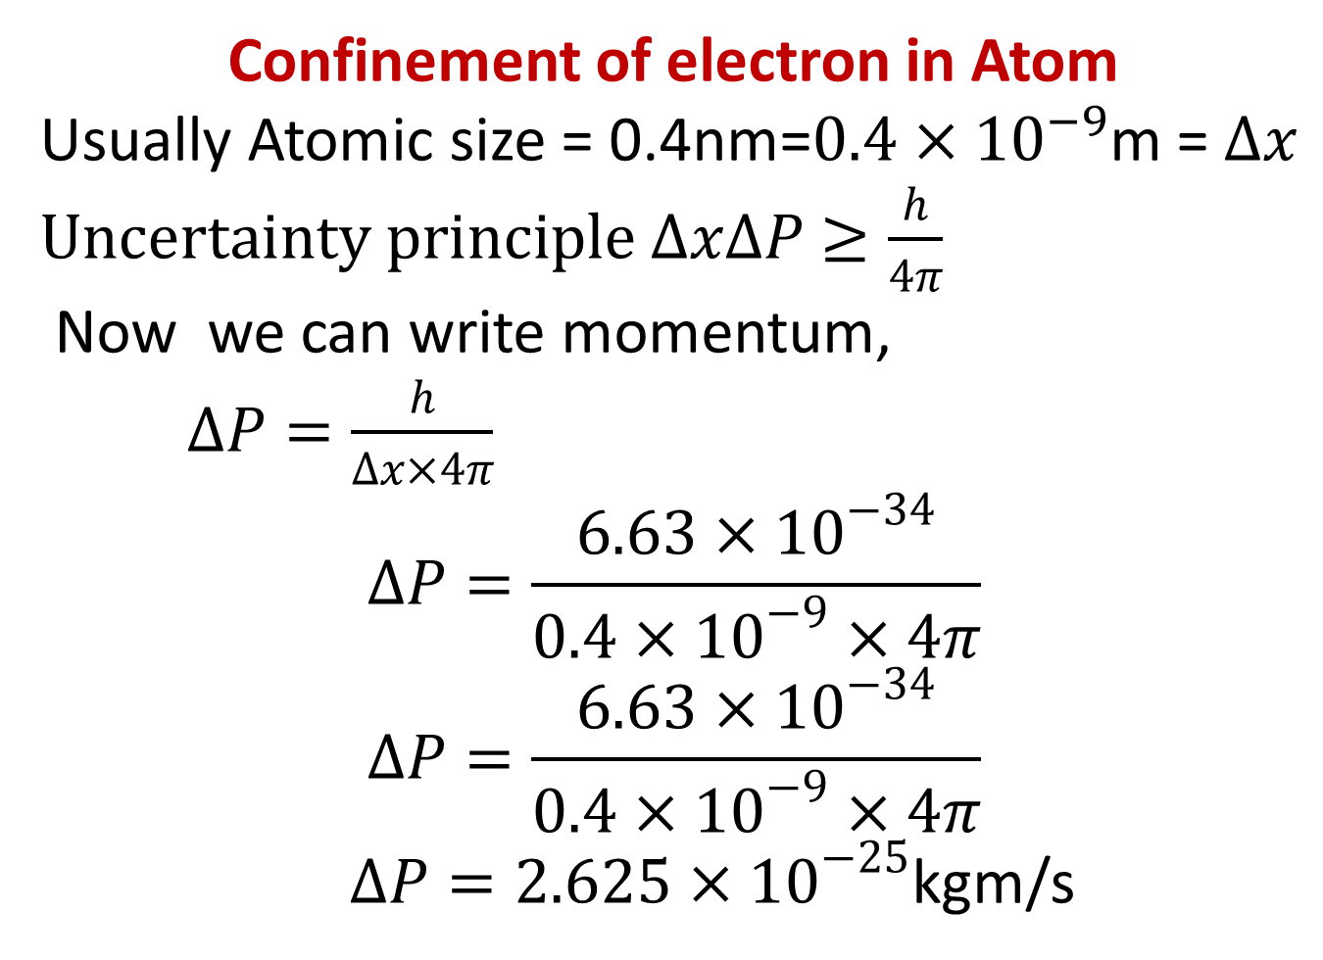
Confinement of electron in Atom
Usually Atomic size = 0.4nm=$0.4×{10}^{−9}$m = $∆x$ $Uncertainty principle ∆x∆P≥\frac{h}{4π}$
Now we can write momentum,
$∆P=\frac{h}{∆x×4π}$
$$∆P=\frac{6.63×{10}^{−34}}{0.4×{10}^{−9}×4π}$$
$$∆P=\frac{6.63×{10}^{−34}}{0.4×{10}^{−9}×4π}$$
$∆P=2.625×{10}^{−25}$kgm/s

Slide 35
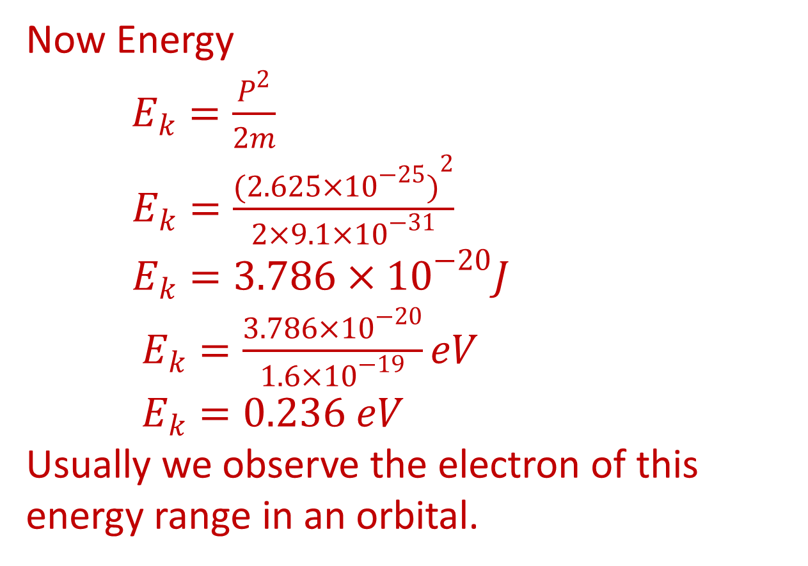
Now Energy
$E_{k}=\frac{P^{2}}{2m}$
$E_{k}=\frac{{(2.625×{10}^{−25})}^{2}}{2×9.1×{10}^{−31}}$
$E_{k}=3.786×{10}^{−20}J$
$E_{k}=\frac{3.786×{10}^{−20}}{1.6×{10}^{−19}}eV$
$E_{k}=0.236 eV$
Usually we observe the electron of this energy range in an orbital.

Slide 36
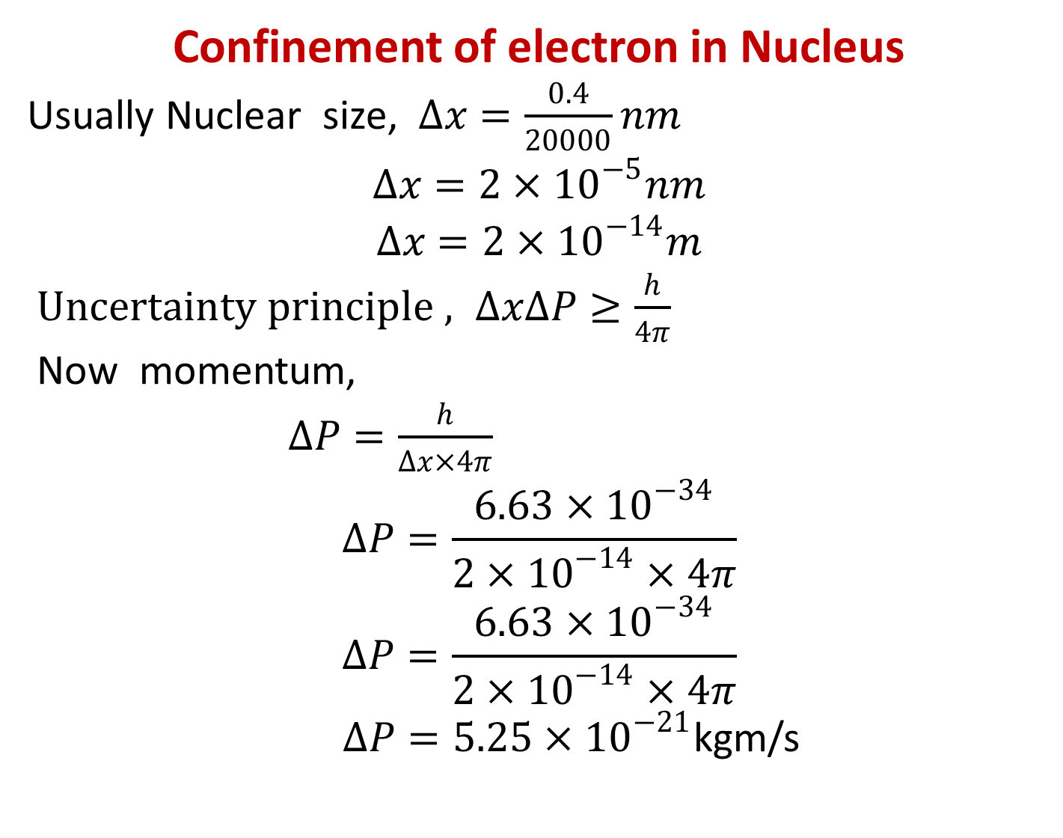
Confinement of electron in Nucleus
Usually Nuclear size, $∆x=\frac{0.4}{20000}nm$
$$∆x=2×{10}^{−5}nm$$
$$∆x=2×{10}^{−14}m$$
$Uncertainty principle , ∆x∆P≥\frac{h}{4π}$
Now momentum,
$∆P=\frac{h}{∆x×4π}$
$$∆P=\frac{6.63×{10}^{−34}}{2×{10}^{−14}×4π}$$
$$∆P=\frac{6.63×{10}^{−34}}{2×{10}^{−14}×4π}$$
$∆P=5.25×{10}^{−21}$kgm/s

Slide 37
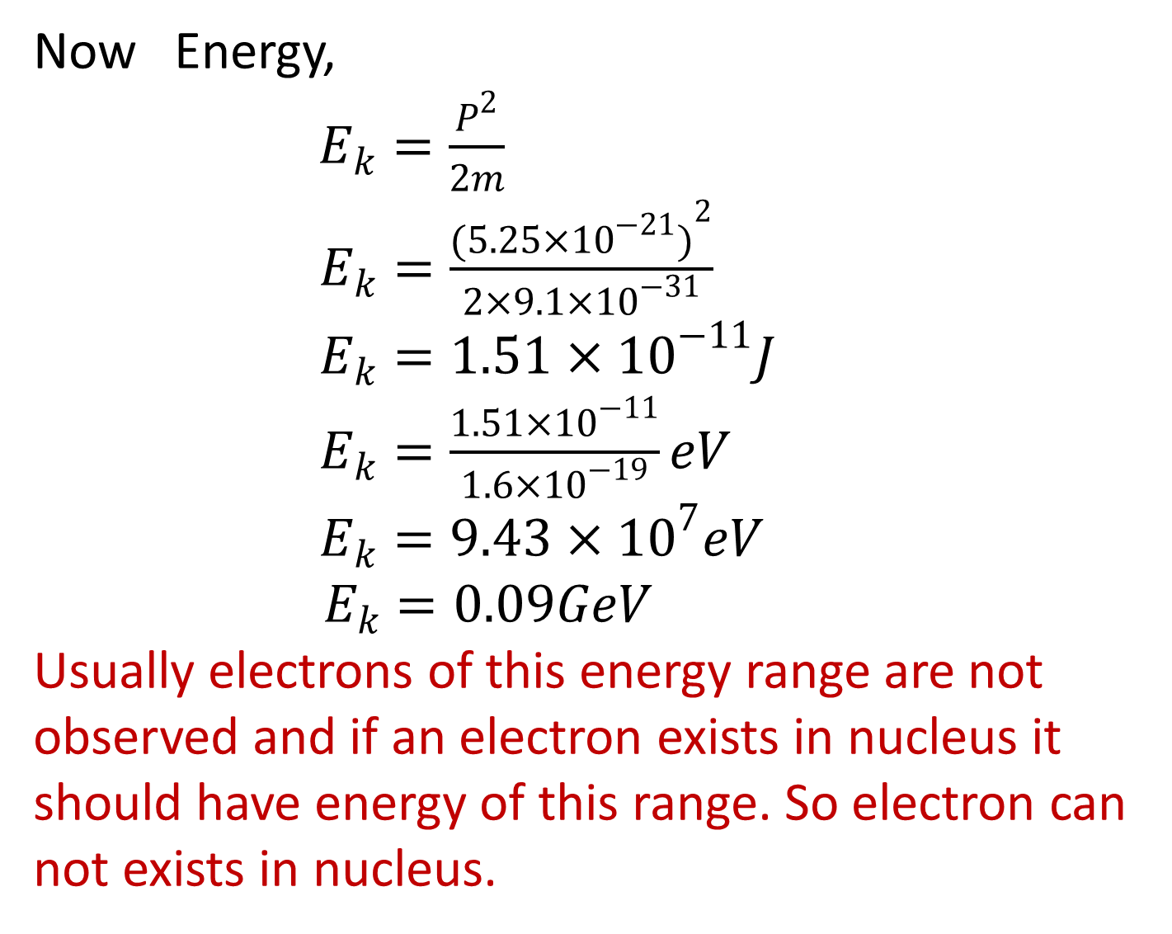
Now Energy,
$E_{k}=\frac{P^{2}}{2m}$
$E_{k}=\frac{{(5.25×{10}^{−21})}^{2}}{2×9.1×{10}^{−31}}$
$E_{k}=1.51×{10}^{−11}J$
$E_{k}=\frac{1.51×{10}^{−11}}{1.6×{10}^{−19}}eV$
$E_{k}=9.43×{10}^{7}eV$
$E_{k}=0.09GeV$
Usually electrons of this energy range are not observed and if an electron exists in nucleus it should have energy of this range. So electron can not exists in nucleus.

Slide 38
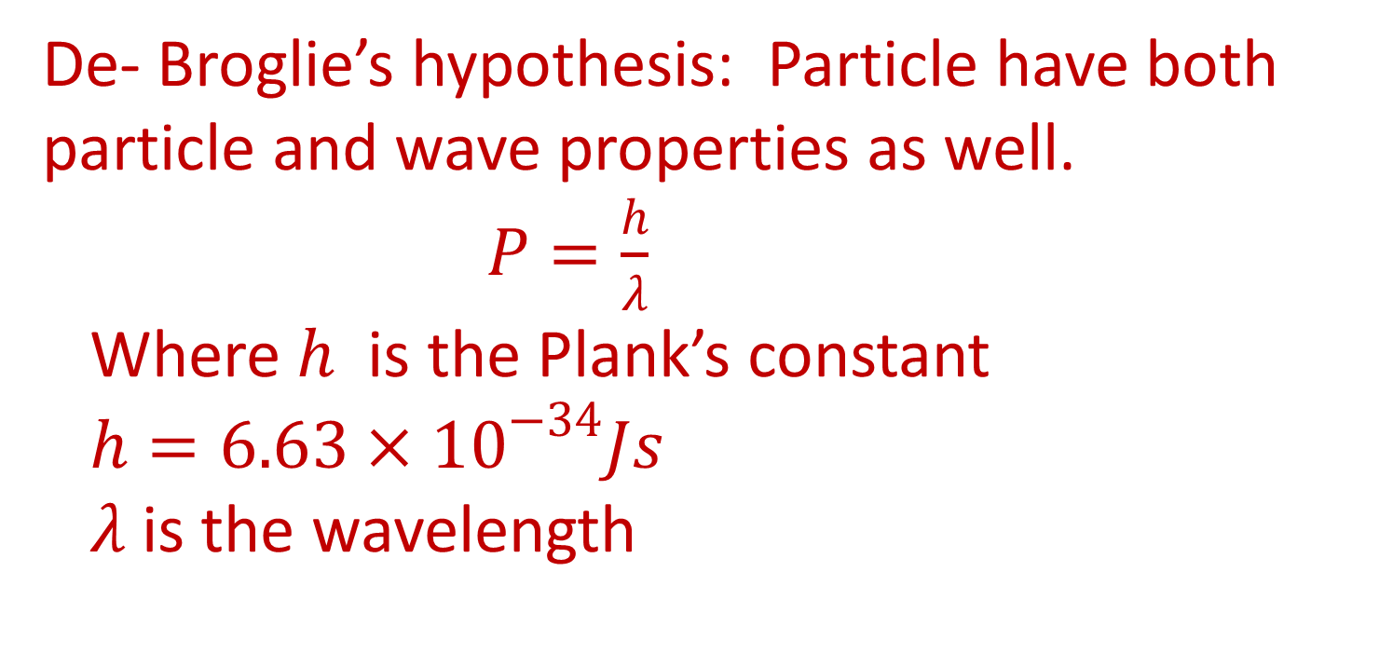
De- Broglie’s hypothesis: Particle have both particle and wave properties as well.
$P=\frac{h}{λ}$
Where $h$ is the Plank’s constant
$h=6.63×{10}^{−34}Js$
$λ$ is the wavelength

Slide 39
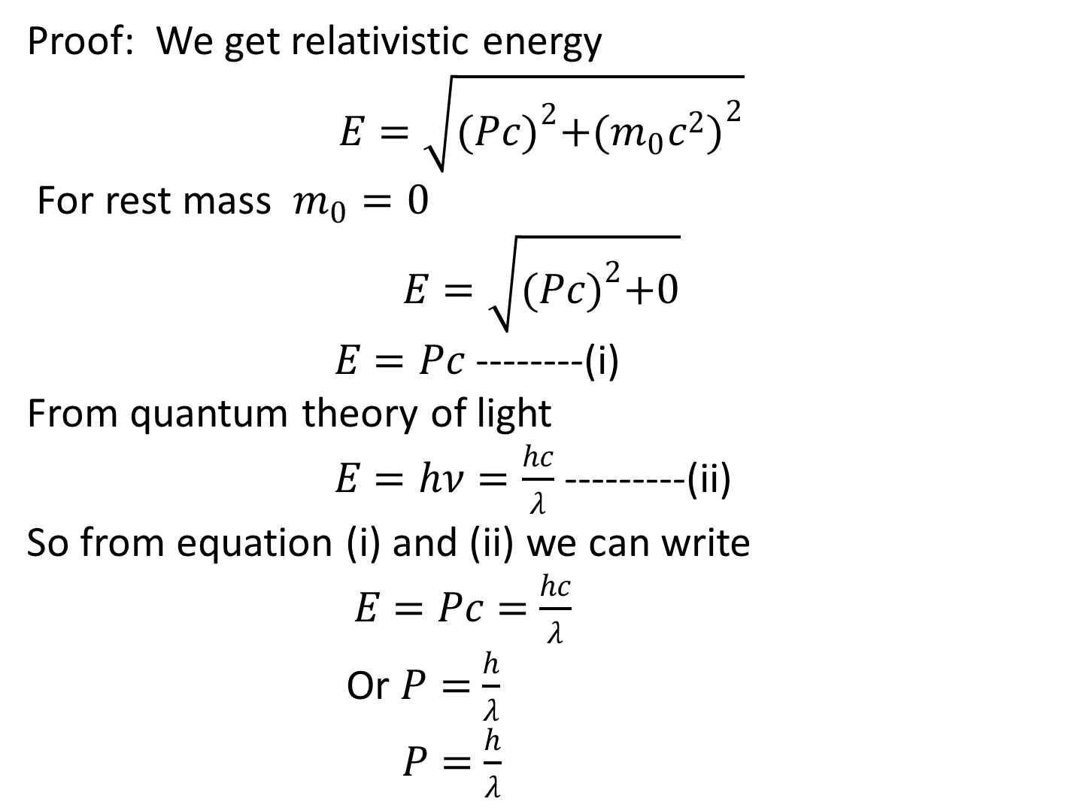
Proof: We get relativistic energy
$$E=\sqrt{{(Pc)}^{2}+{(m_{0}c^{2})}^{2}}$$
For rest mass $m_{0}=0$
$$E=\sqrt{{(Pc)}^{2}+0}$$
$E=Pc$ --------(i)
From quantum theory of light
$E=hν=\frac{hc}{λ}$ ---------(ii)
So from equation (i) and (ii) we can write $E=Pc=$ $\frac{hc}{λ}$
Or $P=$ $\frac{h}{λ}$
$P=$ $\frac{h}{λ}$

Slide 40
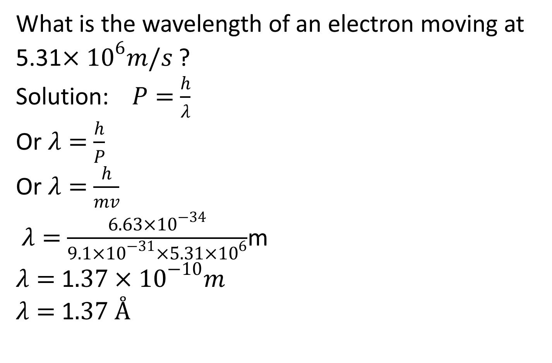
What is the wavelength of an electron moving at 5.31$×{10}^{6}m/s$ ?
Solution: $P=$ $\frac{h}{λ}$
Or $λ=$ $\frac{h}{P}$
Or $λ=$ $\frac{h}{mv}$
$λ=$ $\frac{6.63×{10}^{−34}}{9.1×{10}^{−31}×5.31×{10}^{6}}$m
$λ=$ 1$.37×{10}^{−10}m$
$λ=$ 1$.37 Å$

